Slide 1

Chillin’ with crypto
Dadene- Daniel Demi & Nelson,

Slide 2
Overview
Our project aims to look at three crypto coins that we believe could rival Bitcoin and Ethereum as long-term investments.
Motivation - We all know the cryptocurrency market is all the rage right now but all you hear about it Bitcoin and Ethereum. We wanted to look at 3 coins we believe could possibly challenge their trends in the future.
User Story- We can't measure Fear and Greed... But we can look at data trends!

Slide 3
Research QUestions
1. Are the cryptocurrencies we are looking at worth investing in?
2. Will these currencies be sustainable over a 5, 10, 15, and 30 year period?
3. How will these currencies perform against Bitcoin and Ethereum?
4. What kind of correlation does these 5 cryptocurrencies have against the S&P500?

Slide 4

Digital Currencies
CRYPTOCURRENCIES
Bitcoin
Ethereum
Solana
Litecoin
Cosmos

Slide 5
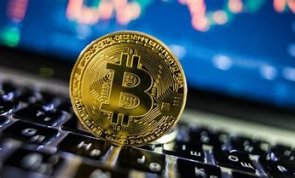
BITCOIN
Decentralized cryptocurrency originally thought of in 2008, launched in 2009 using the alias by Satoshi Nakamoto.
It’s a peer-to-peer online currency.
Bitcoin holds the distinction of being the first-ever cryptocurrency to come into actual use.
Market Cap of USD $691,371,258,373
Circulating supply of 18,939,006
Supply of 21,000,000 BTC coins.

Slide 6
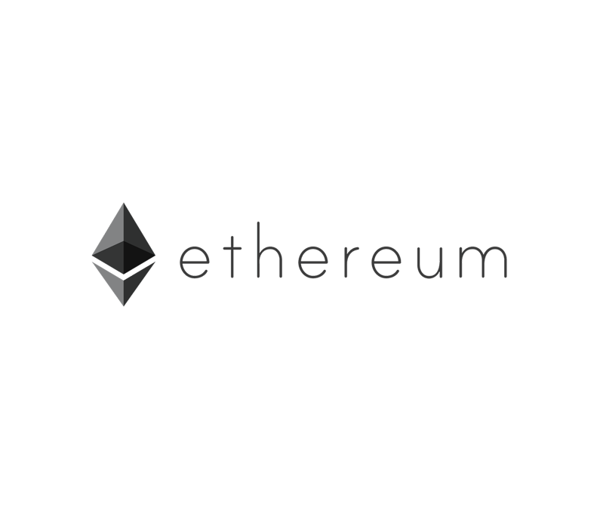
ETHEREUM
Decentralized open-source blockchain system that features its own cryptocurrency. Established in 2013 by Vitalik Buterin
ETH works as a platform for numerous other cryptocurrencies, as well as for the execution of decentralized smart contracts.
Market Caps $305,654,657,364 USD
Circulating Supply 119,400,000

Slide 7
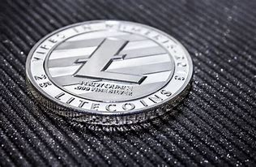
LITECOIN
Litecoin was created by a former Google employee Charlie Lee.
Litecoin is the 2nd most popular currency
Market Cap $7.6B USD
Circulating Supply 69,494,732
Max Supply 84.000.000 LTC Coins
Notes:
January 2021, it’s one of the most used widely accepted crypto and more than 2000 merchants and stores now accept LTC such as Remax, G2A.com, CryptoGames & UnlockBase

Slide 8

COSMOS
Cosmos bills itself as a project that solves some of the “hardest problems” facing the blockchain industry.
Co-Founders Jae Kwon, Zarko Milosevic and Ethan Buchman.
Live market cap of $8.4B USD.
Has a circulating supply of 286,370,297 ATOM coins
Notes:
January 2021, it’s one of the most used widely accepted crypto and more than 2000 merchants and stores now accept LTC such as Remax, G2A.com, CryptoGames & UnlockBase.
It aims to offer an antidote to “slow, expensive, unscalable and environmentally harmful” proof-of-work protocols, like those used by Bitcoin, by offering an ecosystem of connected blockchains. .

Slide 9

SOLANA
Solana is a project that banks on blockchain technologies. It was launched in 2020 by the Solana foundation with headquarters in Geneva, Switzerland.
Solana is known in the cryptocurrency space because of the incredibly short processing times the blockchain offers. With lightning-fast processing times, Solana has attracted a lot of institutional interest as well.
Market Cap $29B
Circulating Supply 314,832,901
Notes:
January 2021, it’s one of the most used widely accepted crypto and more than 2000 merchants and stores now accept LTC such as Remax, G2A.com, CryptoGames & UnlockBase.
It aims to offer an antidote to “slow, expensive, unscalable and environmentally harmful” proof-of-work protocols, like those used by Bitcoin, by offering an ecosystem of connected blockchains. .

Slide 10
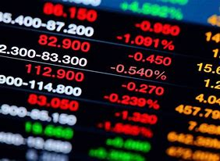
S&P500
stock market index tracking the performance of 500 large companies listed on stock exchanges in the United States
Some companies on here are Amazon, Capital One, Apple, Microsoft.
Market cap 40.7T

Slide 11
STRUCTURE
We collaborated on the main task and the roles fell into places.
Nelson worked on the S&P 500 correlation and data clean up.
Dan worked on the Montecarlo simulation & Data plotting/clean up.
Demi worked on the research & preliminary framework for presentation.
Challenges – Time, finding datasets, didn’t assign roles/responsibility efficiently
Successes – Got the code to work and finished the project within the deadline

Slide 12

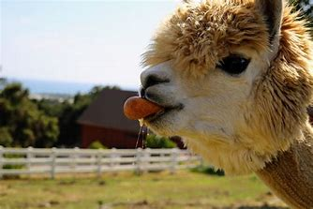

Dataset
Alpaca API- used for Monte Carlo Simulation
Panda Data reader- Datasets for each crypto
S&P500 csv - provided by Google Finance

Slide 13

Demo slide
https://github.com/Mosi-oa-tunya-2022/dadene.git

Slide 14

Any Questions, Comments, Or Concerns?

